Slide 1

Database Systems
Lab 17 Application Database Connectivity (CRUDS)
View, Search, Add, Update and Delete Records
subexpert.com

Slide 2
Objectives
subexpert.com
To learn:
Application Database Connectivity
Case Study – MIS with Employees Record
Use Cases with partial UC Diagram
Data Model
Database Connectivity in Java
Implementation of Use Cases

Slide 3
Case Study – Online Shopping System
Introduction to the case study
Steps
Setup Database in SQL Server
Sync Code from GitHub
Junk Solution to violate Model-View separation principle
Object Oriented Solution with GRASP and some other principles

Slide 4
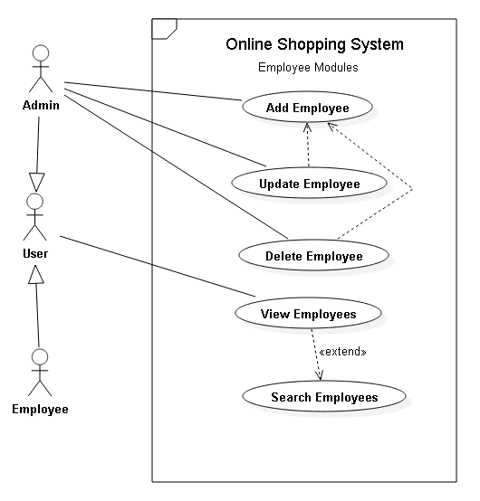

Slide 5
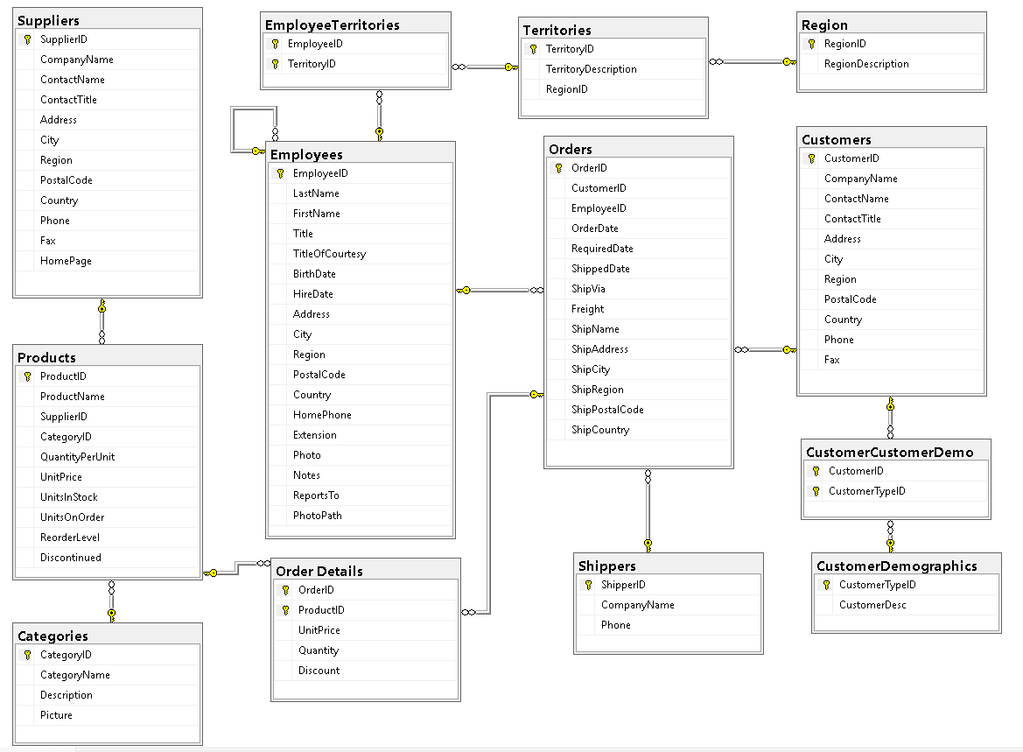
Northwind Database
https://docs.microsoft.com/en-us/dotnet/framework/data/adonet/sql/linq/downloading-sample-databases

Slide 8
Functions – Pros & Cons
Pros
Cons
In function body SELECT (read) data is allowed
Allow complex arithmetic operations
Allow programming
Support input parameters
Uses return statement to return single or table data
Allow to call store procedures (next lab)
Can be called as part of DML statements
In function body No insert, Update and Delete statement are allowed
Table state cannot be modified like views
No support for output parameter
Cannot use stored procedures in the body since “exec sp_name” is not possible

Slide 9
Functions – Types
Scalar Valued Functions
Returns single value
E.g. GETDATE(), GetBalanace()
Table Valued Functions
Single Statement Functions
View with parameters
Only SELECT statement without programming
Multi Statement Functions
For complex requirements
Allow programming, cursors

Slide 10
Step 3 Set Classes
You must have at least one course to create classes and every class can have one or more courses.
Class Management
View Class, Create, Delete Class
Class Students Management
Class Students Vs Candidate Students
Tips for Class Management
Auto Entry Flow
Ensure class student count

Slide 11
Step 4 Set Course Contents
Contents Maturity Process
Course Outlines
Lectures Management
Add / Update / Delete Lecture
Add your lecture sections with visibility and TOC
Control Visibility
Link Topics
At least one with 10+ questions
Manage Topics and Questions on Topics
MCQs, TF, FiB, Short Conceptual Questions
View Answer, Move Questions, Add to Exam Cart, Edit and Delete
Visibility Control, Questions Levels

